Slide 1
POD 01 PENSION MANAGEMENT SYSTEM
MENTOR: MR. ANURAG KULKARNI
TEAM MEMBERS:
SHUBHAM KUMAR - 885059
VAIBHAV VIBHANDIK - 885113
AMOGH SHITRE – 841537
NEHA SHILAMKAR - 885179

Slide 2
TABLE OF CONTENTS
1. HARDWARE AND SOFTWARE REQUIREMENTS
2. INTRODUCTION
3. USE CASE DIAGRAM
4. MICROSERVICES USED
5. MICROSERVICES OVERVIEW & UI PAGES
6. PROJECT DEPLOYMENT IN AWS

Slide 3
HARDWARE AND SOFTWARE REQUIREMENTS
1. Hardware Requirement:
a. Developer Desktop PC with 8GB RAM.
2. Software Requirement (Java):
a. Spring Tool Suite (STS) Or any Latest Eclipse.
i. AWS Code Commit Enabled.
ii. Configure Maven in Eclipse.
b. Maven.
c. Docker (Optional).
d. Postman Client in Chrome.

Slide 4
INTRODUCTION
A pension is a fund into which a sum of money is added during an employee's employment years and from which payments are drawn to support the person’s retirement from work.
State government aims to automate the portion of the Pension detail provisioning. This project covers pensioner detail provision, pension calculate and initiate pension disbursement.

Slide 5
MICROSERVICES USED
1. Authorization Service
2. Process Pension Service
3. Pensioner Detail Service
4. Pension Disbursement Service

Slide 6
USE CASE DIAGRAM
Pension Disbursement Service
Pension Process Service
Pension Management Portal
Pensioner Detail Service
USER
Authorization Service

Slide 7
1. Authorization Services
Service to Service communication has to happen using JWT.
Pass End User session across Microservices.
Token will expire after 30 minutes.

Slide 8
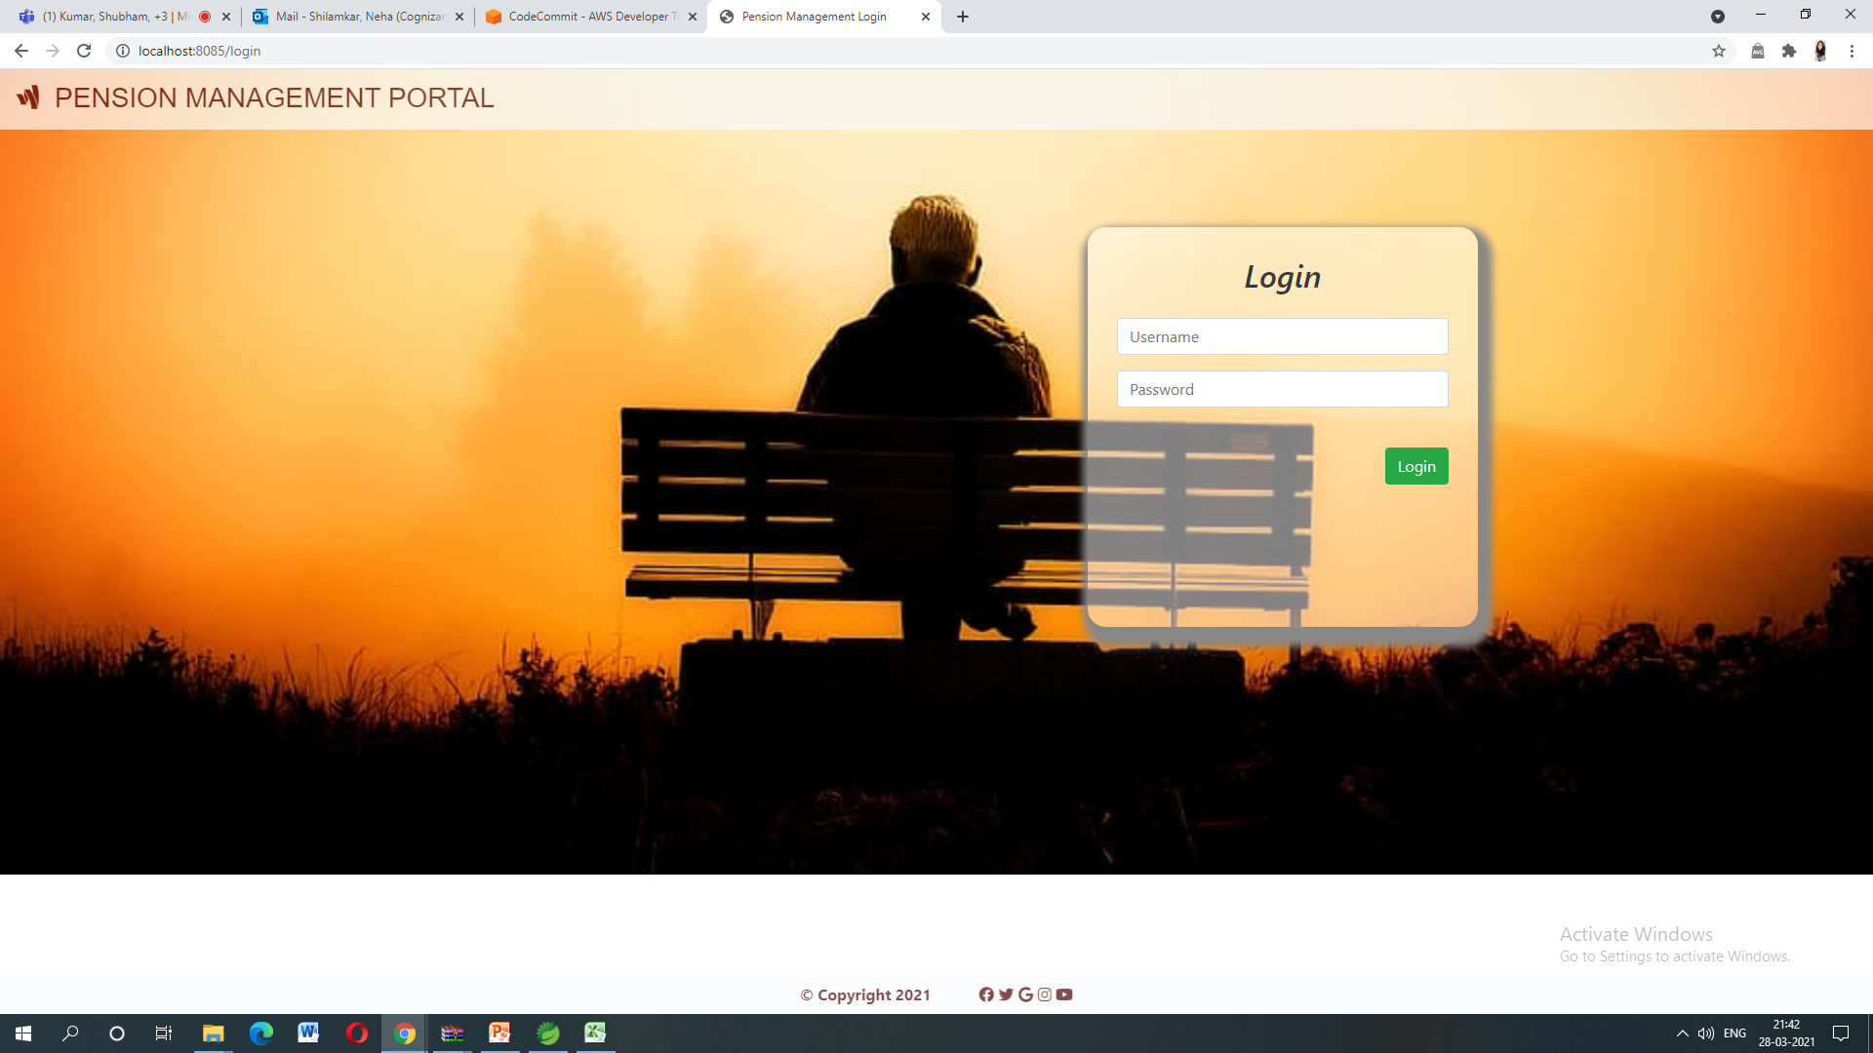
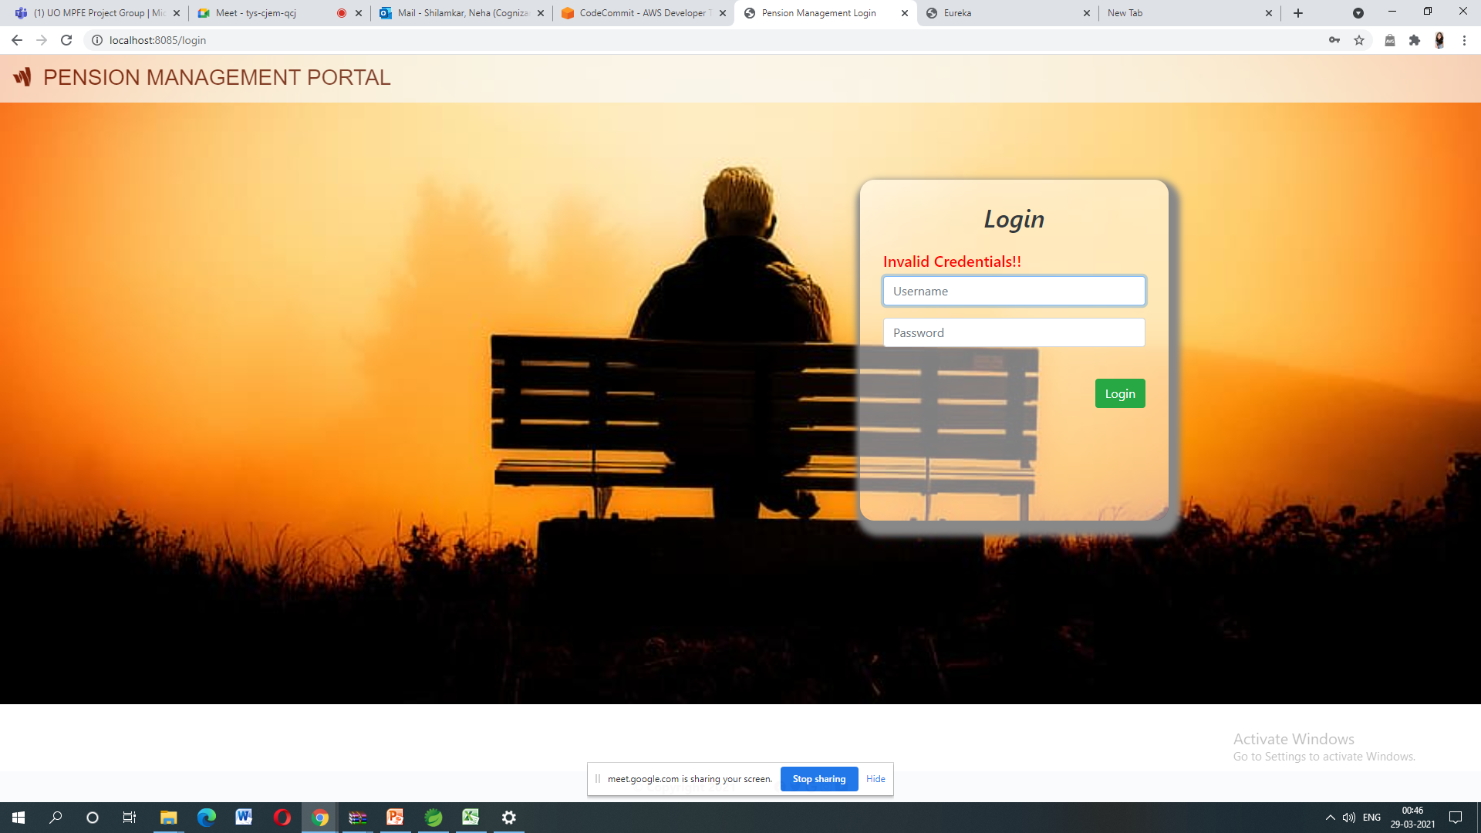

Slide 9
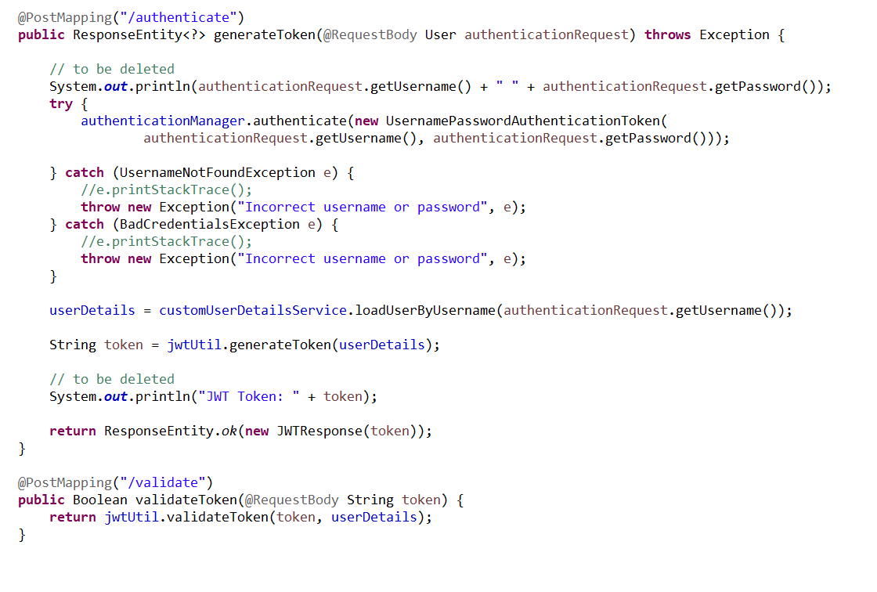

Slide 10
2. Process Pension Service
Process Pension Module is a Middleware Microservice that performs following operations :-
Determines if it’s self or family pension, Calculate the pension amount and display on web application UI interface.
Verifies the pensioner details to process the pension disbursement and initiate the disbursement.

Slide 11
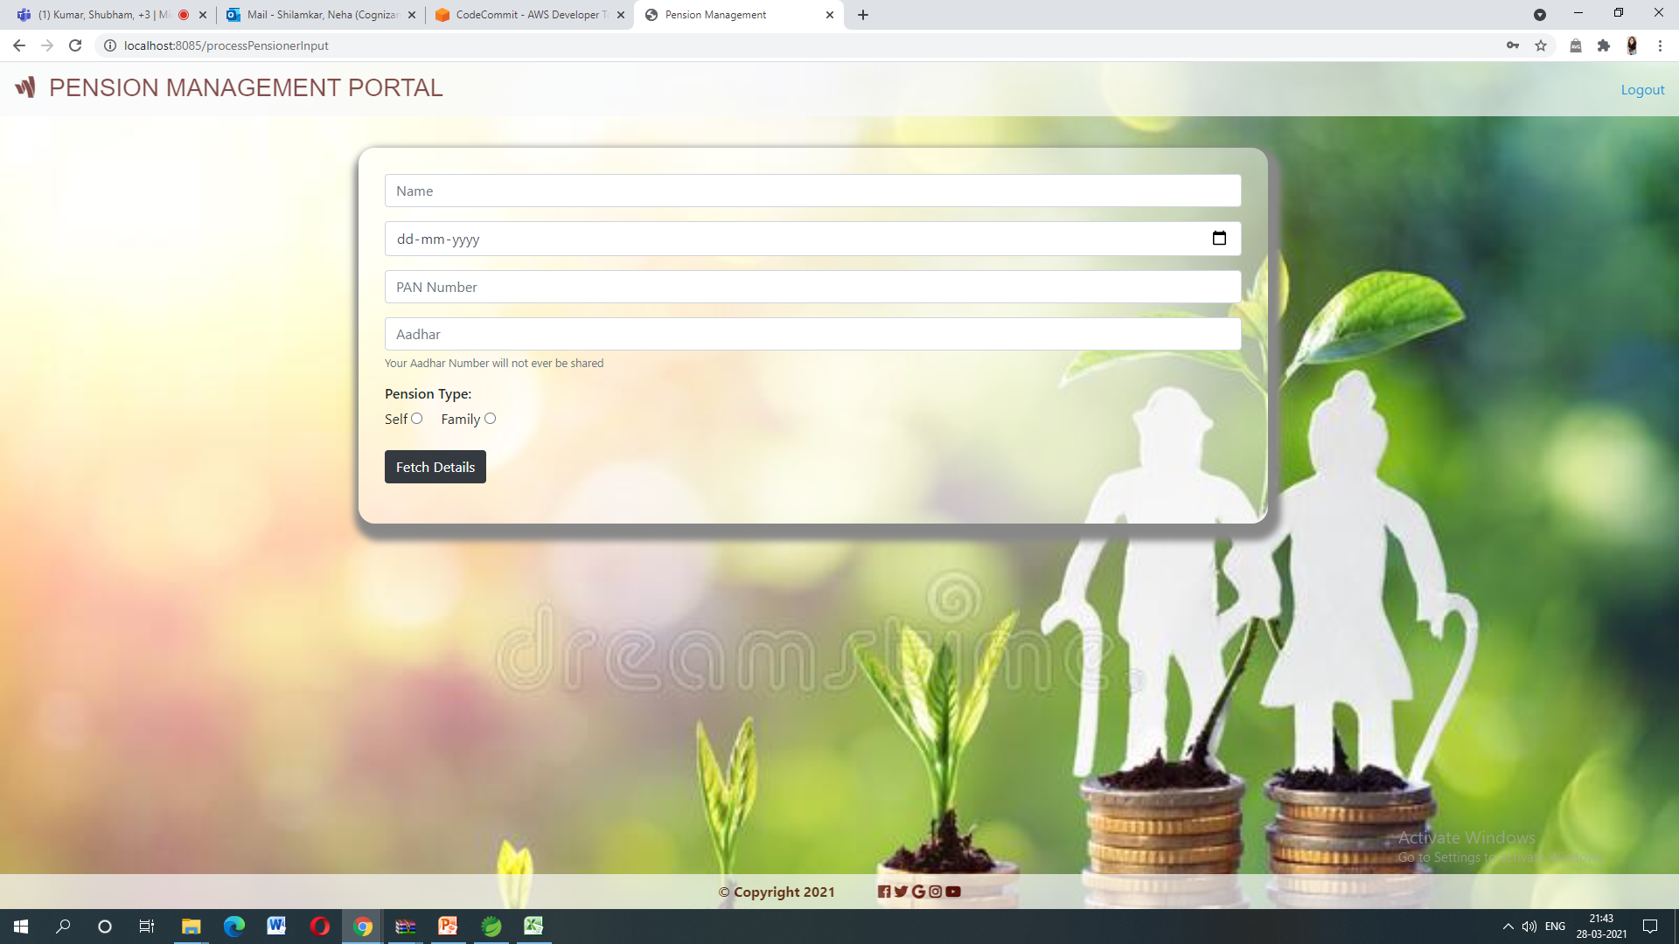
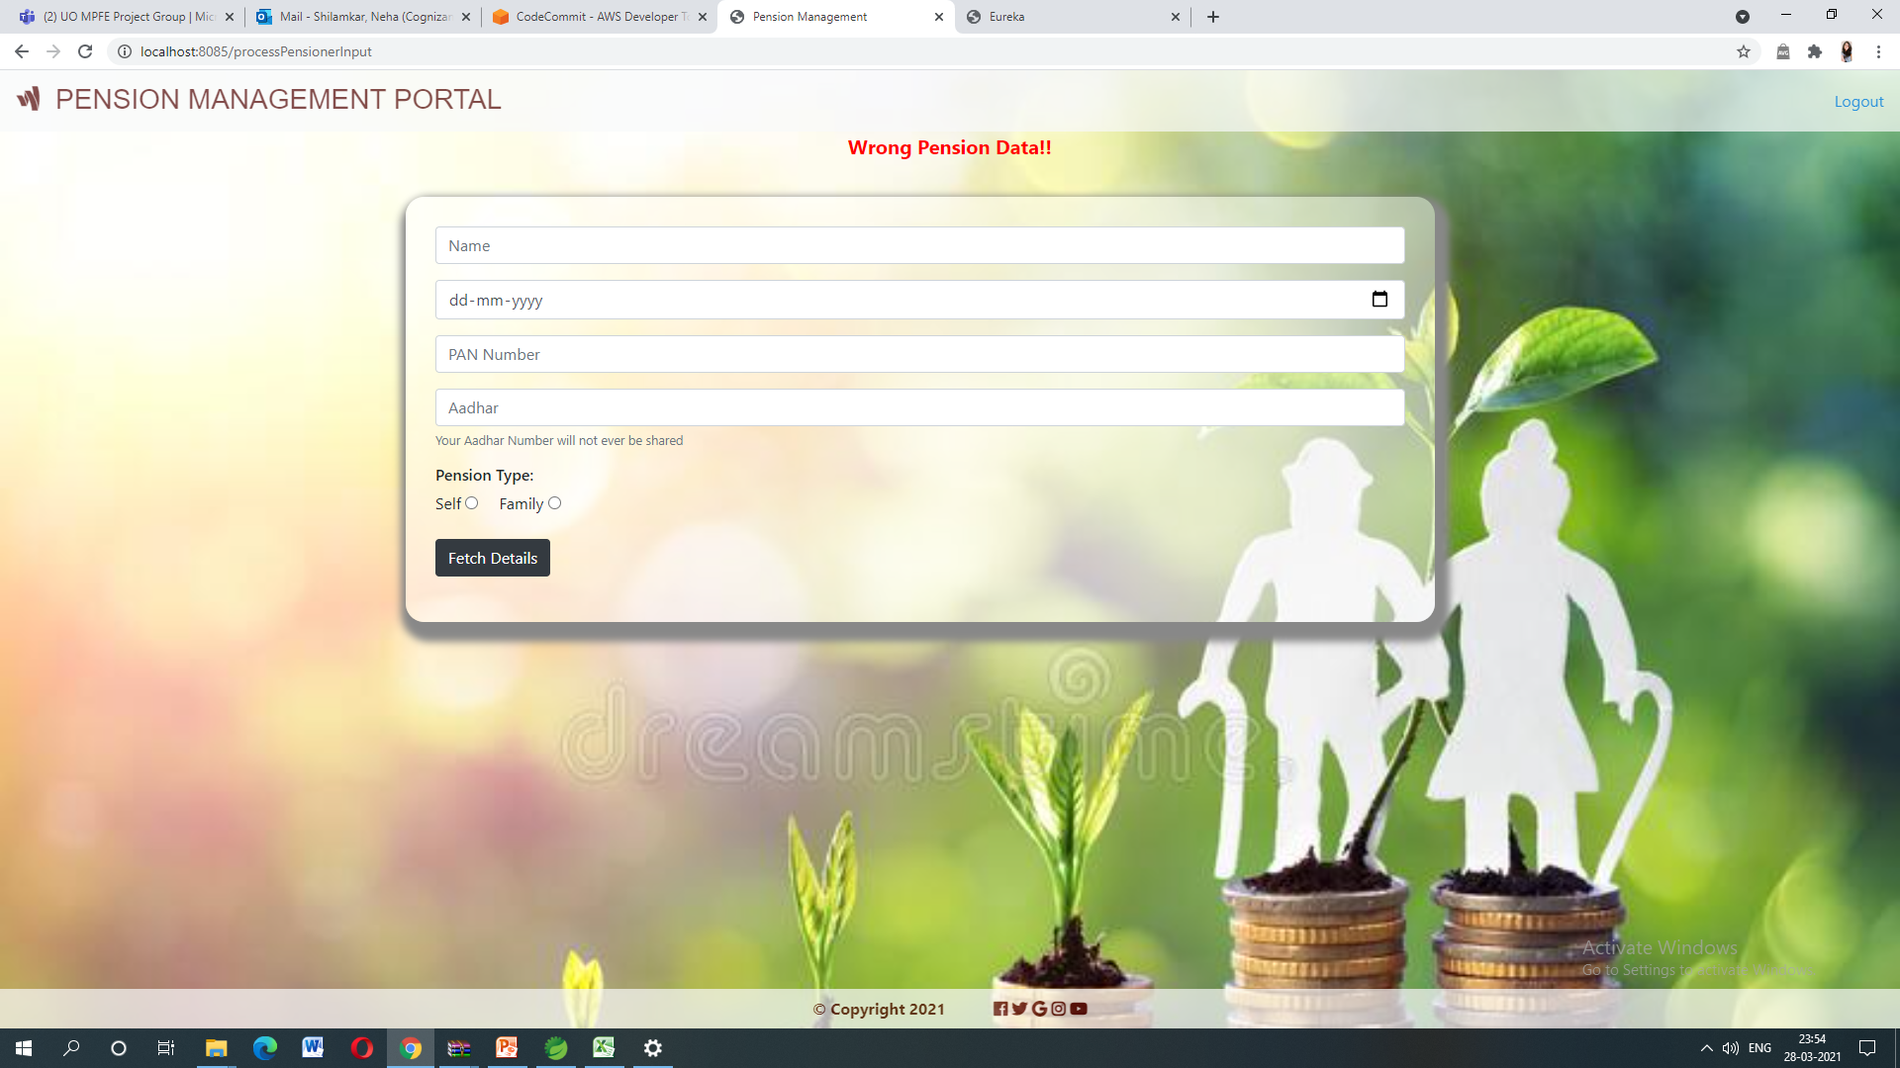
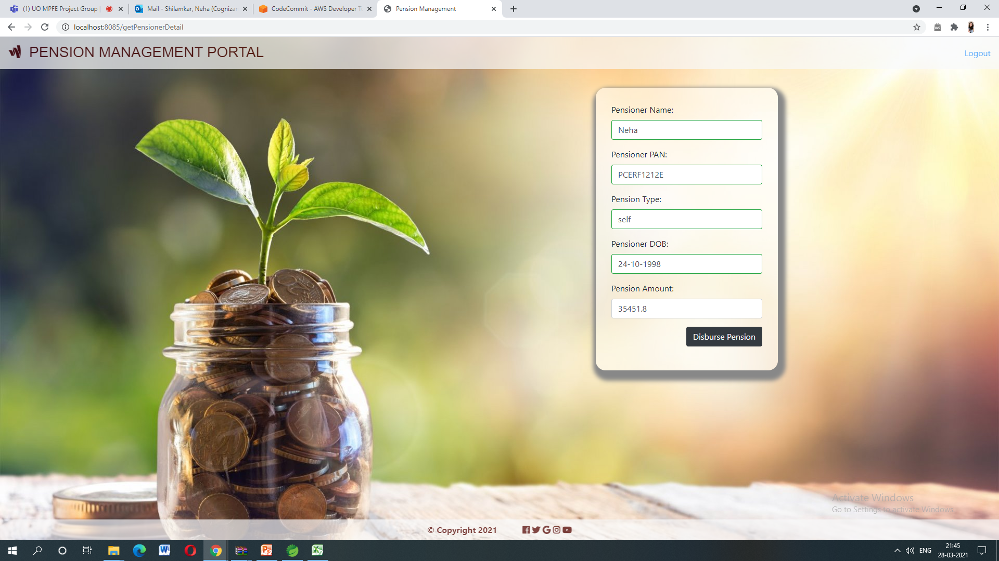

Slide 12
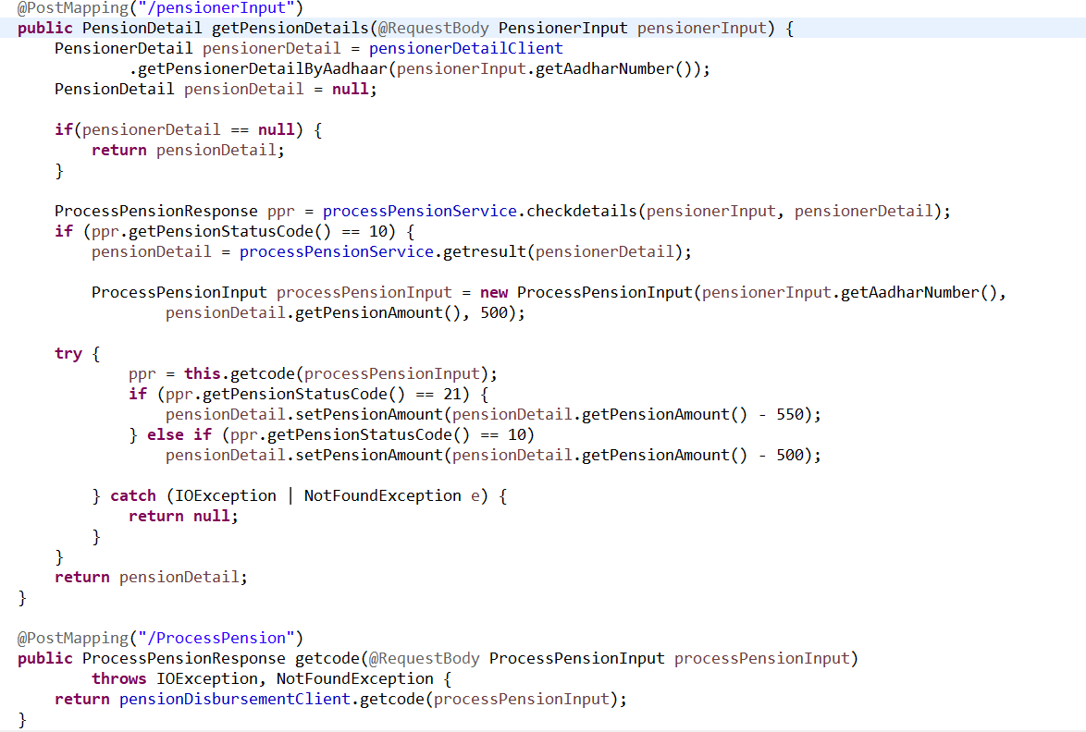

Slide 13
3. Pensioner Detail Service
Pensioner Detail Module is a Middleware Microservice that performs the following operations:-
Provides information about the registered pensioner detail i.e Name, Aadhaar ,Pan ,Date of Birth and other necessary information.

Slide 14
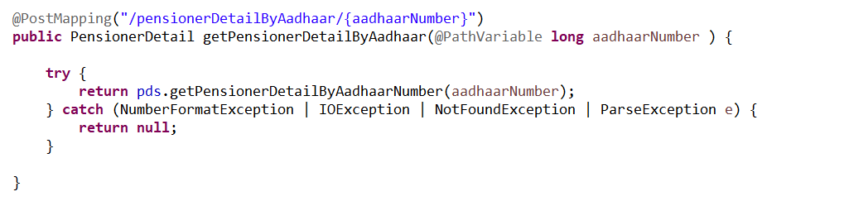

Slide 15
4. Pension Disbursement Service
Pension Disbursement Module is a Middleware Microservice that performs the following operations:-
Gets the pension amount along with aadhaar details and checks for bank service charge and return the appropriate message.

Slide 16
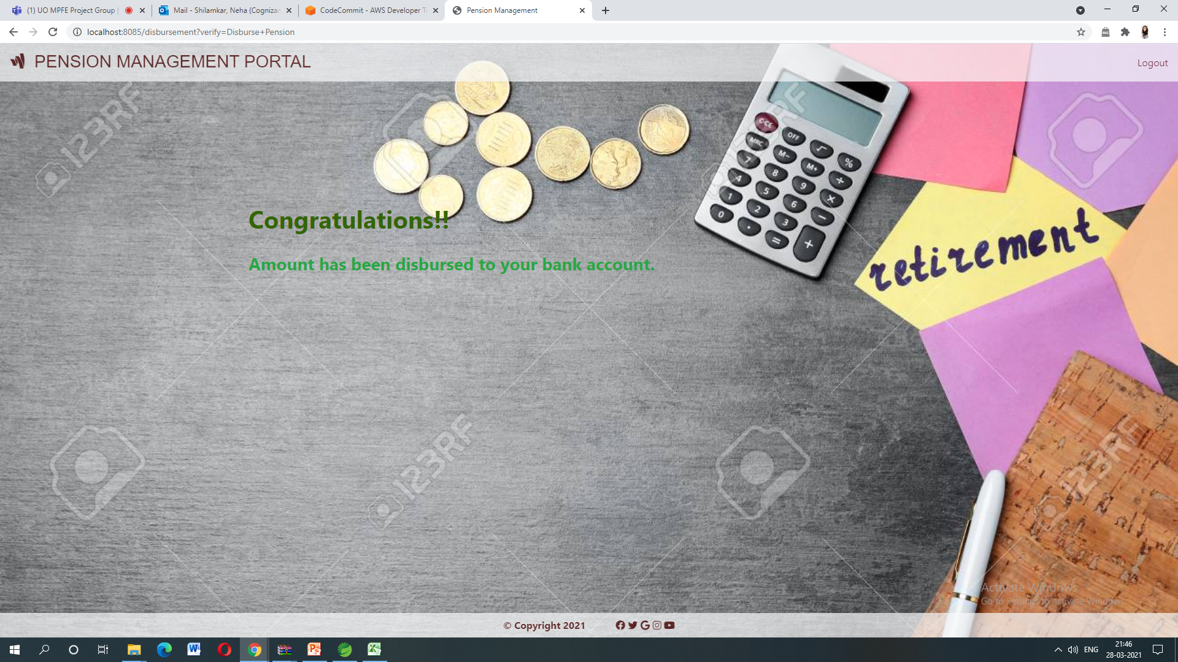

Slide 17
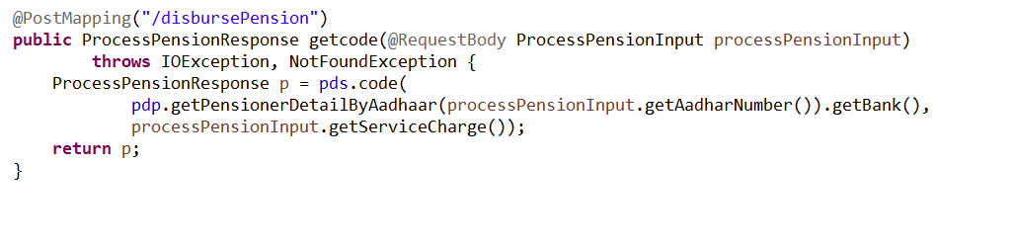

Slide 18
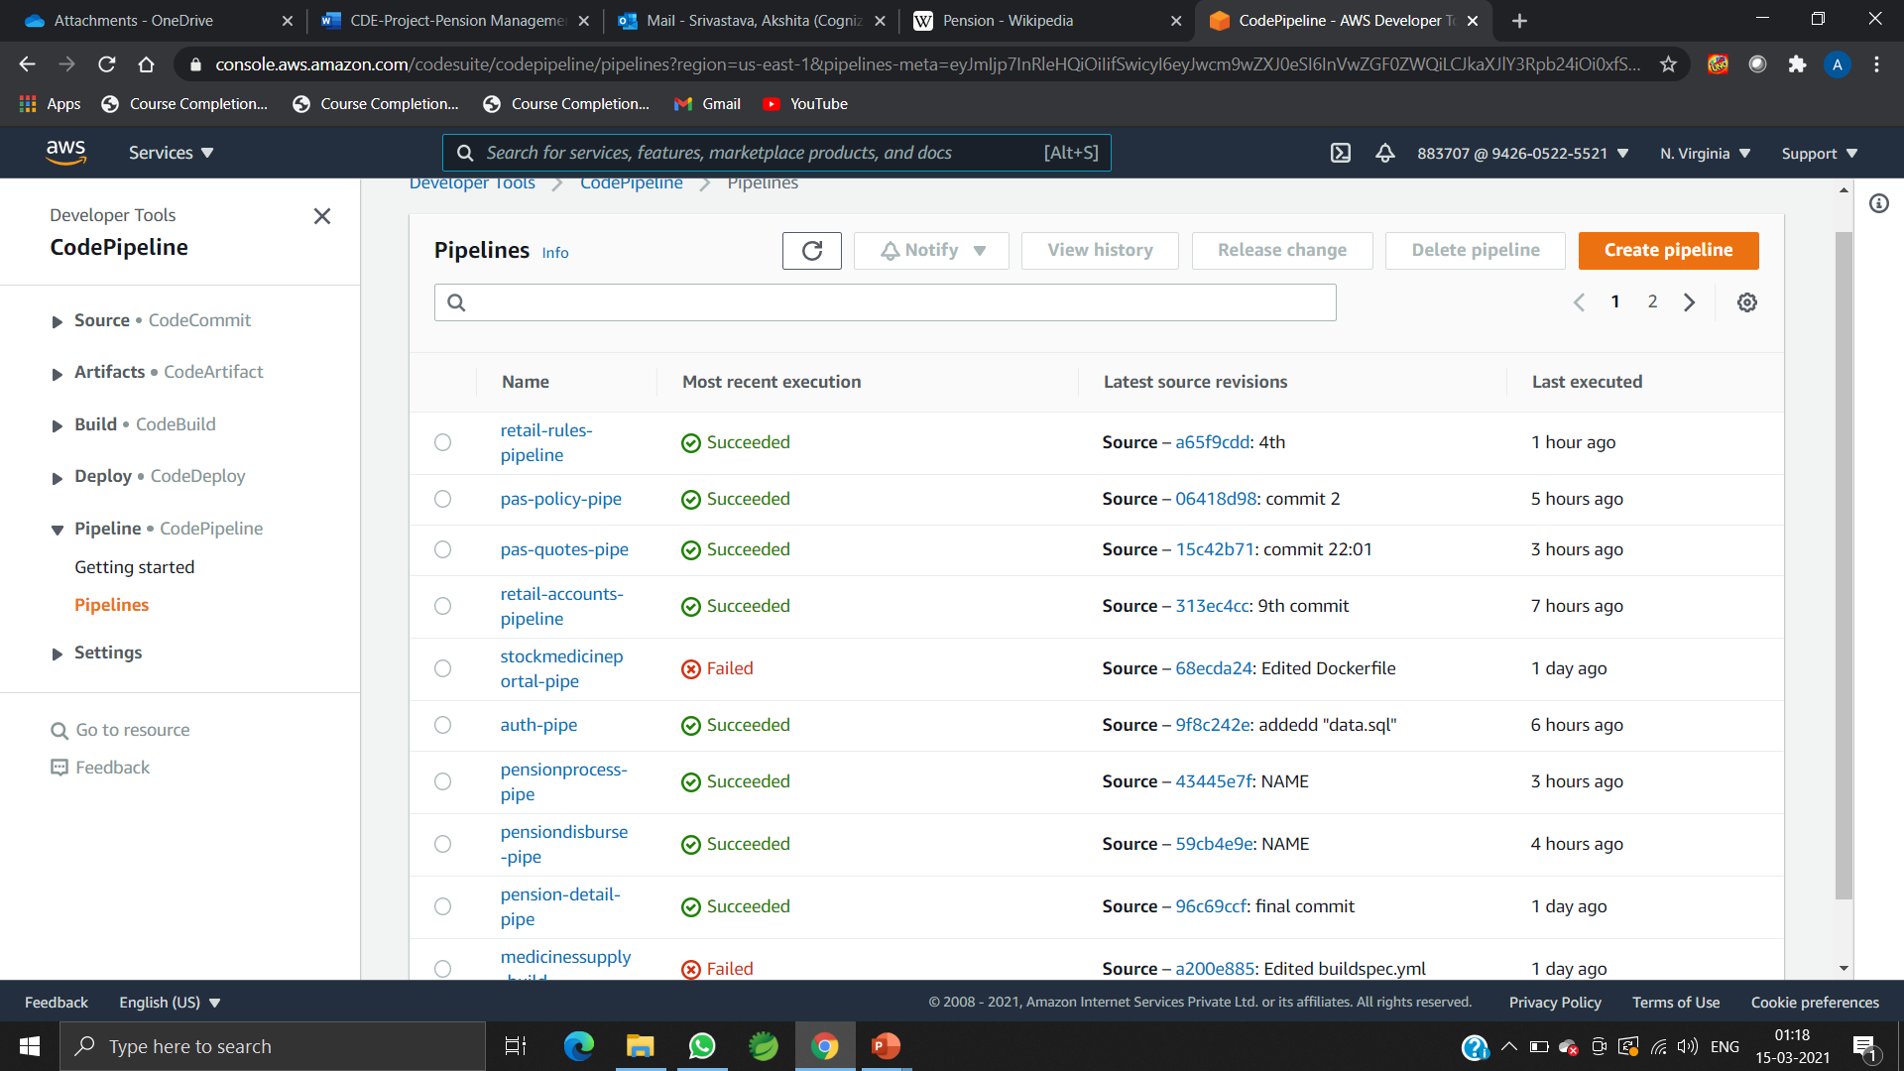
PROJECT DEPLOYMENT IN AWS

Slide 19
THANK YOU

